Slide 1

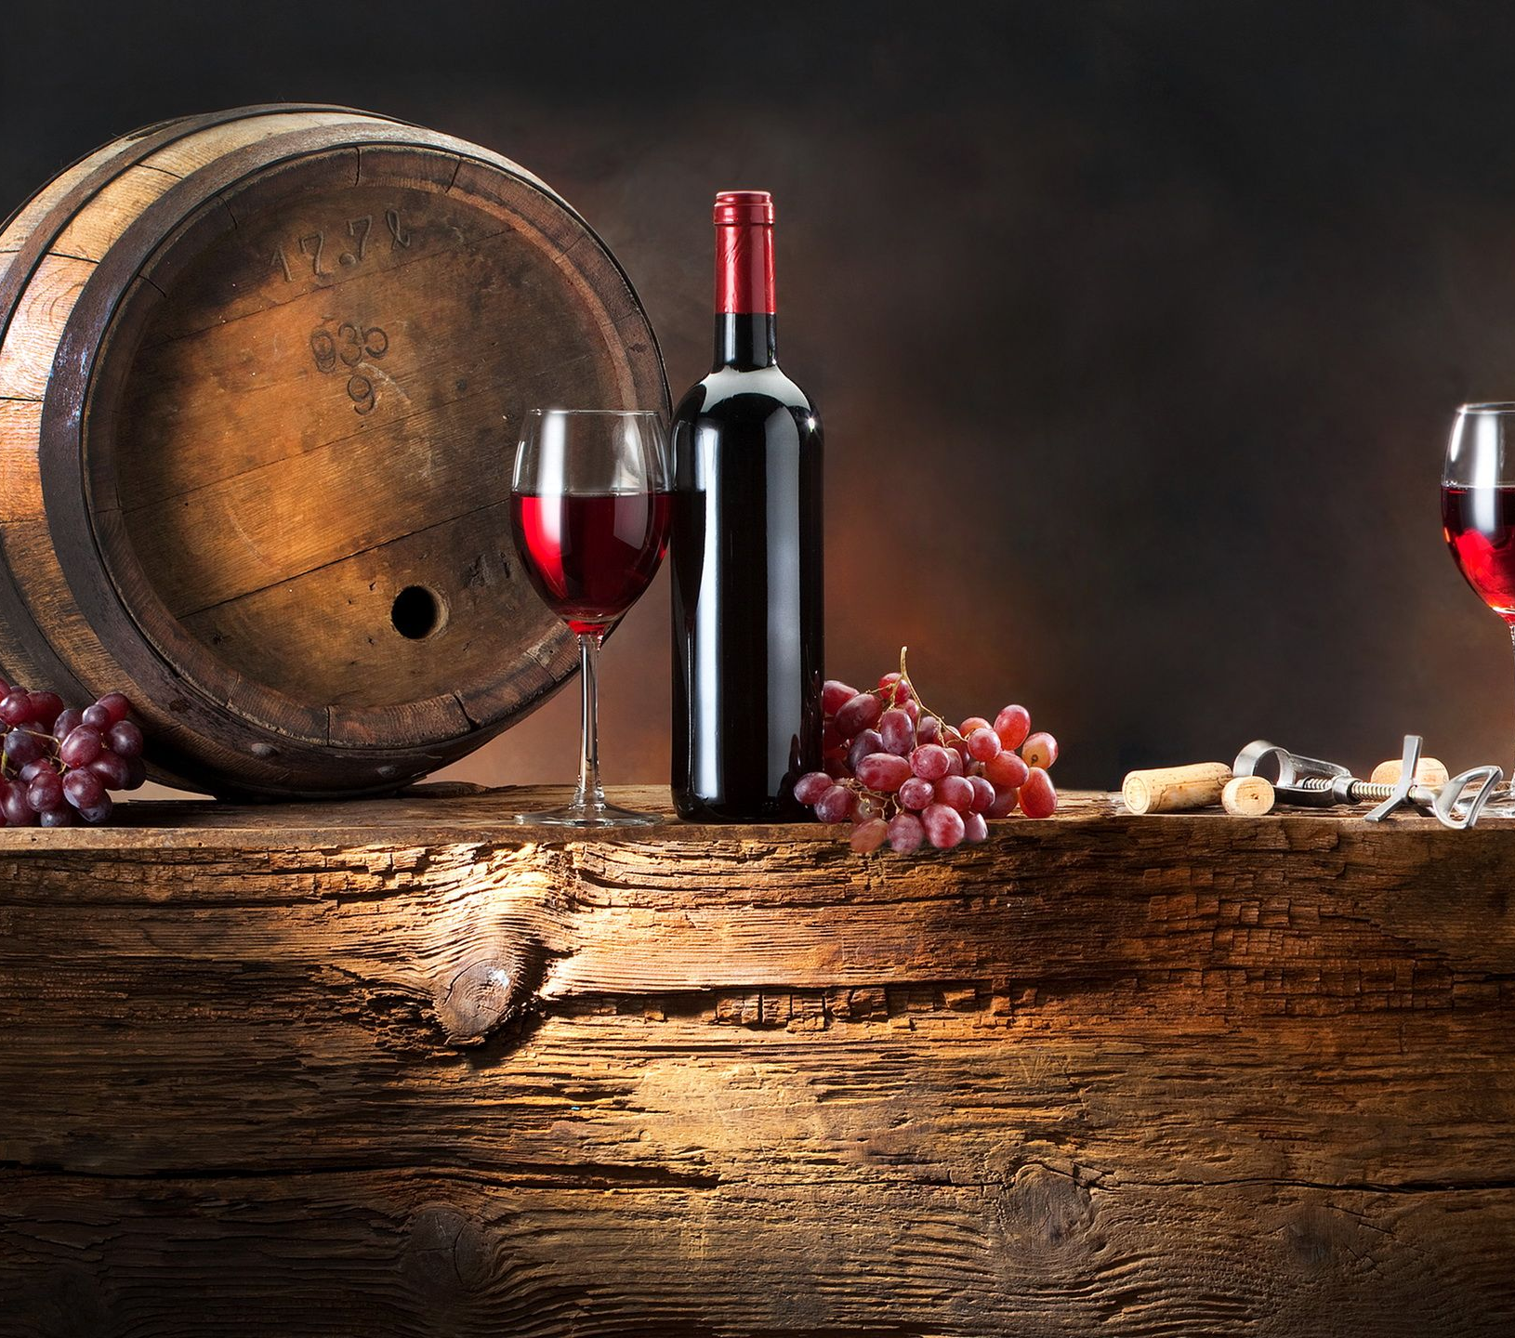
Red Wine Quality Prediction Prepared by Girija Tamang

Slide 2




AI Concept Used
Random Forest Algorithm

Slide 3
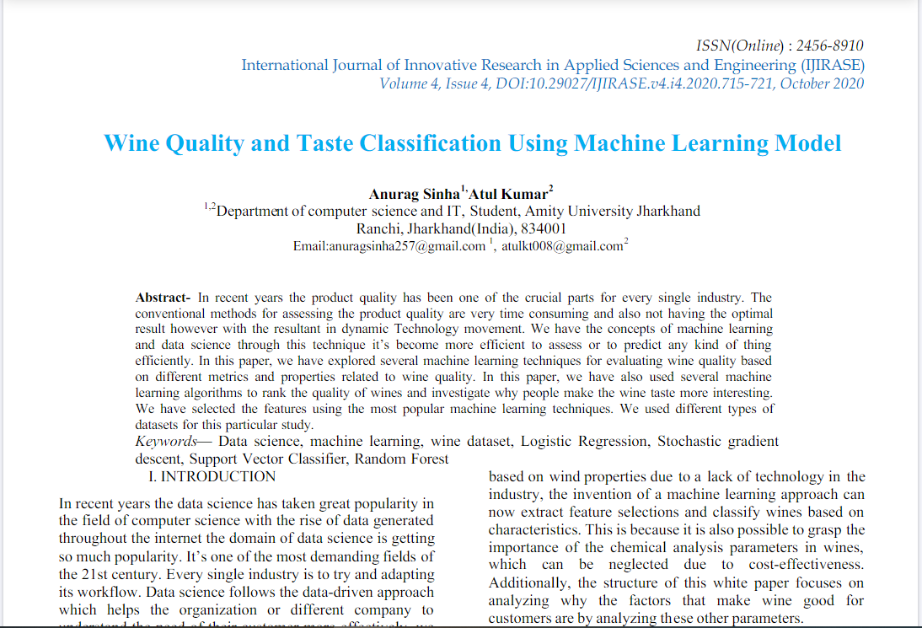
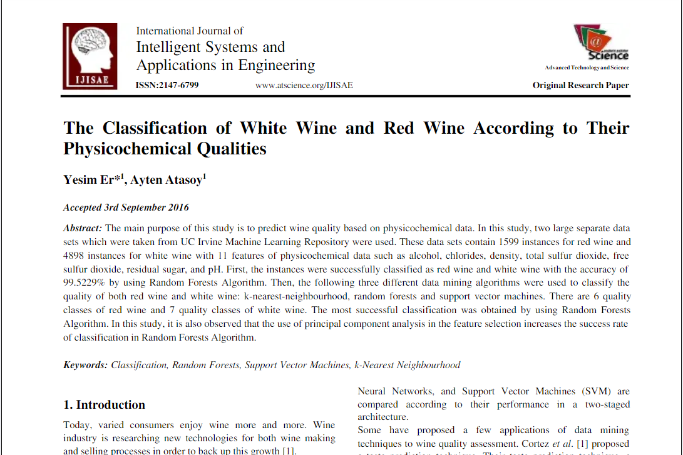
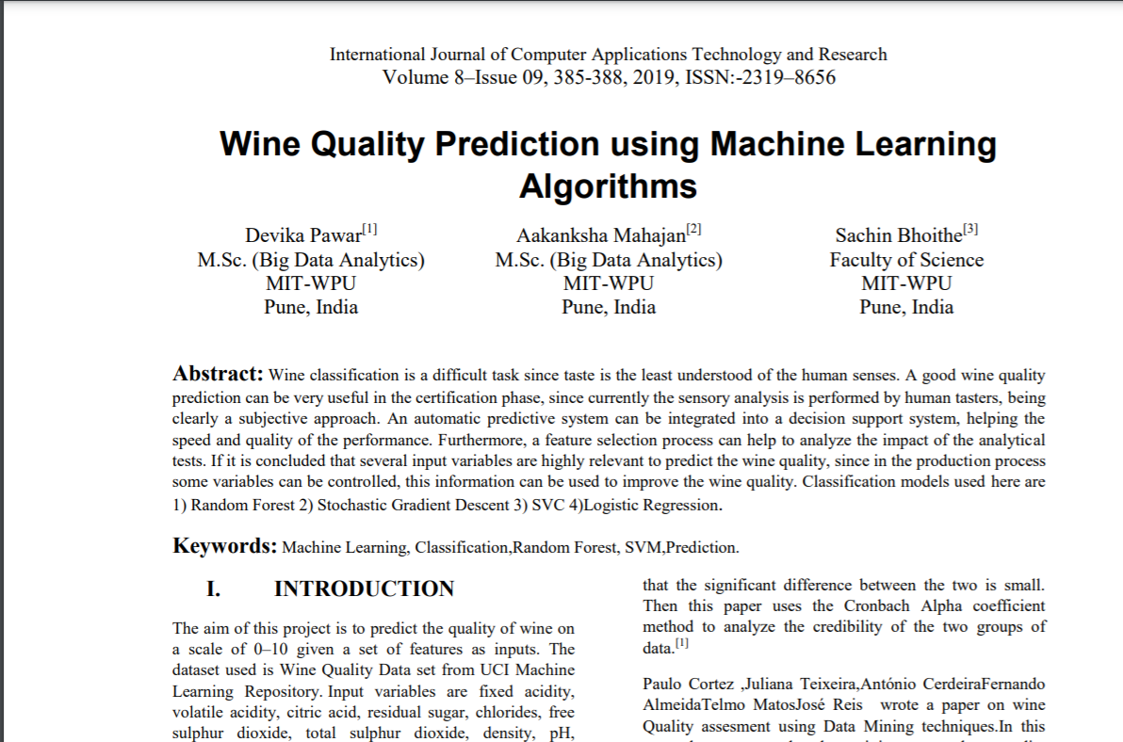
Research Evidences

Slide 4
Reasons for selection of topic
To solve the main problem of wine quality prediction faced by wine industries.
Its interesting to develop a system that can identify and classify the quality of red wine in short period of time.
To reduce the cost and time for predicting the quality of wine.
To help wine industries to produce good quality of wine.

Slide 5
Explanation of the solution and develop application
1. Gathering data
2. Preprocessing Data
3. Splitting the data.
4. Generating Classification model.
5. Prediction.

Slide 6
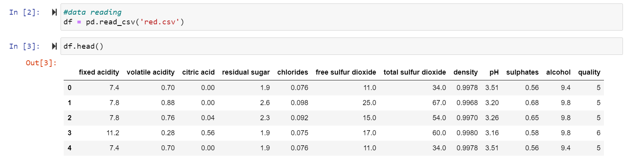
1. Gathering data

Slide 7
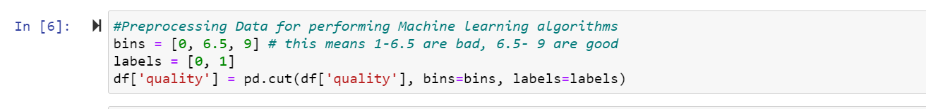
2. Preprocessing Data.

Slide 8
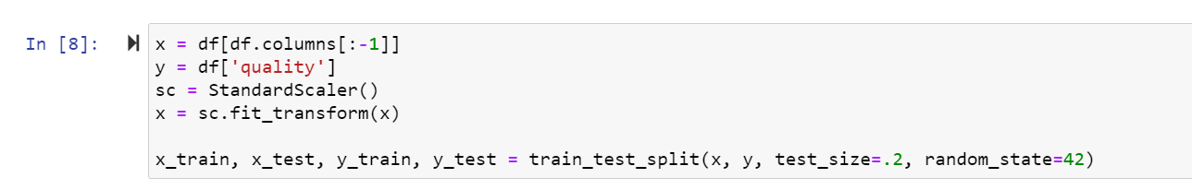
4. Splitting the data.

Slide 9

5. Generating Classification Model:

Slide 10
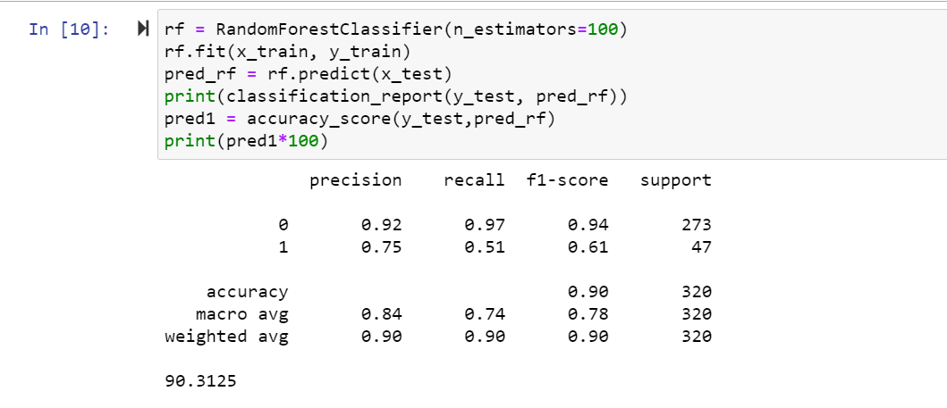
5. Prediction.

Slide 11
Achieved Result

Slide 12
How It Solves the real-world problems
It helps the wine industries to predict the quality of the different type of wines based on certain attributes and also it will be helpful for them to make good product in the future.
It makes it more effective to test, predict or find the quality of wine in a short time without the need for any human expertise.
It saves time and reduces the cost of industries for predicting wine quality.
Manufacturers may use the predictions from this model to improve the quality of wines, certification agencies to better understand aspects of quality that are essential.

Slide 13

Pseudocode of the solution
Step 1: Import Necessary Libraries
Step 2: Load the data set for getting the data of wine.
Step 3: Check how the data set looks or distributed by using dot info attribute and to know how the columns of data are distributed in the dataset, do some plotting.
Step 4: Divide wine as good and bad by giving the limit for the quality and assign a label to the quality variable using label encoding.
Step 5: Separate the data as response variables and feature variables.
Step 6: Split the data into training and testing sets and apply standard scaling to get optimized results. The training and testing data will be ready to perform with machine learning algorithms.
Step 7: Now use a random forest classifier for predicting the quality of red wine.
Step 8: Calculate the accuracy score with the target variable and with the predicted target variable using random forest classifier.

Slide 14
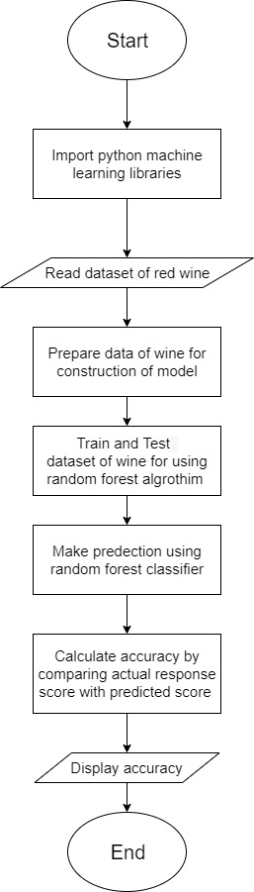
Flowchart of the solution

Slide 15
Thank You

